Slide 1
COMP3521-2 Final Year Project Presentation
iEditio – innovative Second Hand Book trading platform
Presented by Ivan Yu Ho Ming
(11017295)

Slide 2
Overview
Problem encountered
The architecture behind
Case Study of aNobii
Functions I have developed
Problem not yet solved

Slide 3
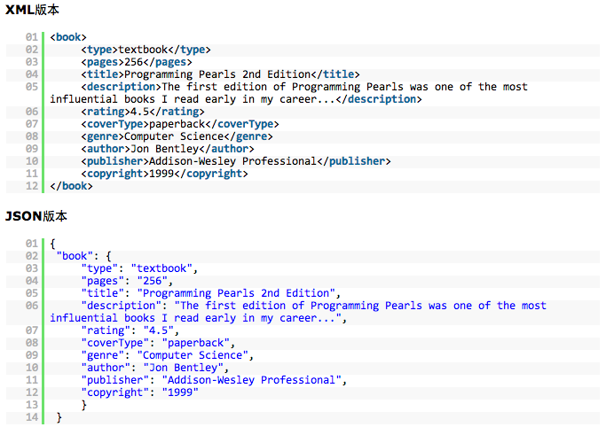
1.Problem Encountered
Database connections
XML VS JSON VS JDBC
JSON - better performance
Why?
JDBC
not supported by
Google natively(unlike JSON)

Slide 4
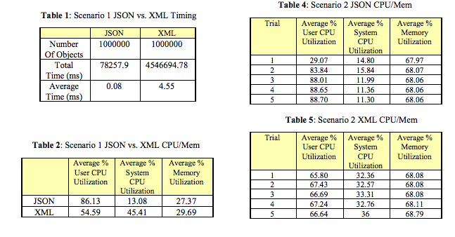
Comparison of JSON and XML Data Interchange Formats: A Case Study http://www.cs.montana.edu/izurieta/pubs/caine2009.pdf

Slide 5
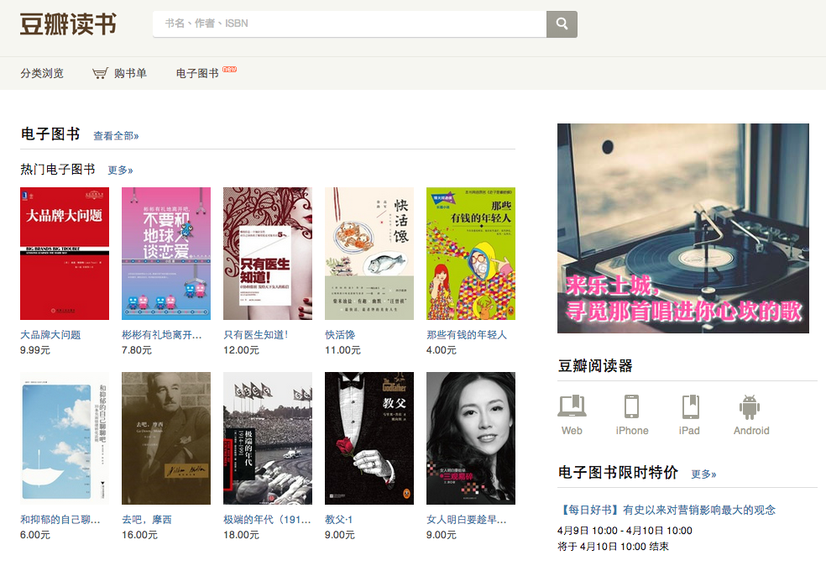
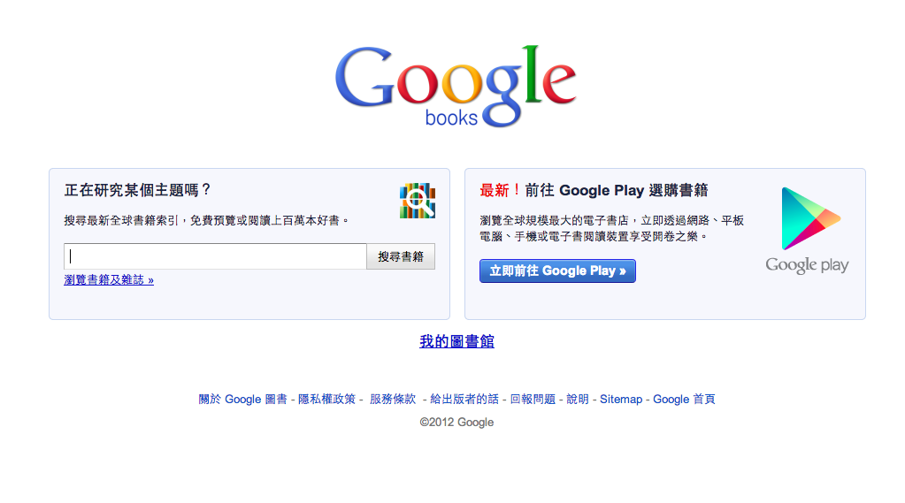
2.Problem encountered
Source of information? Gathered from online information providers e.g. Douban(豆瓣), Google Book in JSON format

Slide 6
Architecture behind
Android APP
Solution:
Decode JSON
Douban/Google Book
Sever
(cslinux1)
Request JSON
Website
Decode JSON
Direct sql connection

Slide 7
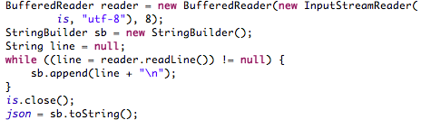
3.Language issues
Douban(豆瓣) is a main source of information for Chinese Books. However, the default JSON decoder is not well supported on Chinese.
Solution: use UTF-8 to decode

Slide 8
4.Getting districts and address
Selling books in location based manner
Getting the GPS signal is easy . . .
since it was supported by android natively
But how can I get the districts and address by the GPS?

Slide 9
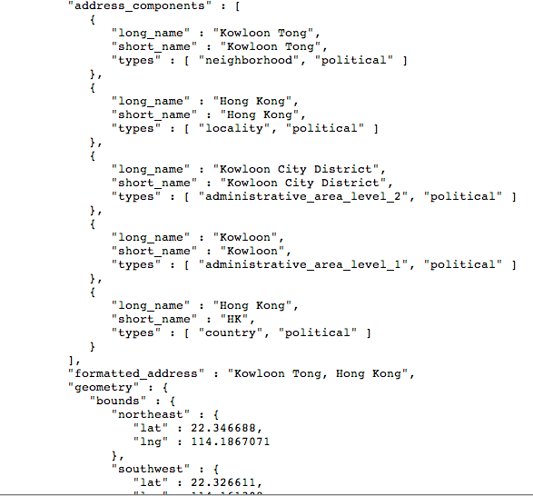
Google Map JSON API
Reverse Geo-coding via cloud query
Getting the address and districts via latitude and longitude
https://maps.googleapis.com/maps/api/geocode/json?latlng=22.3354719802915,114.1839645802915&sensor=true

Slide 10
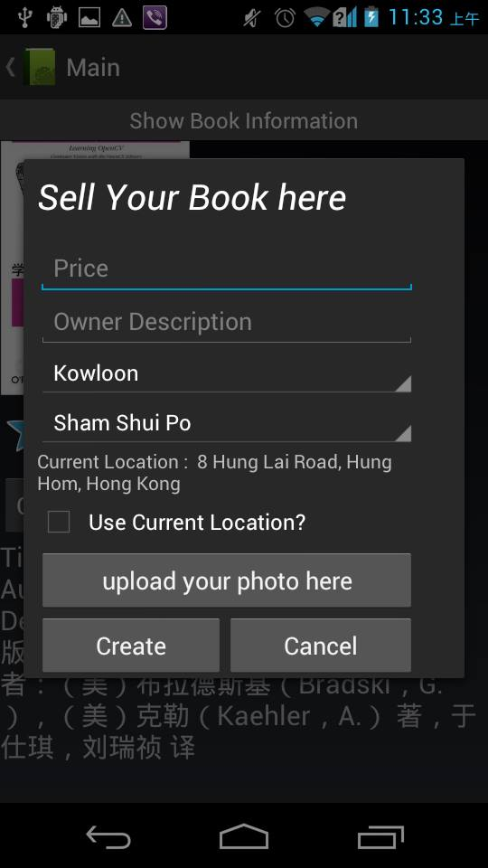
Address and districts

Slide 11
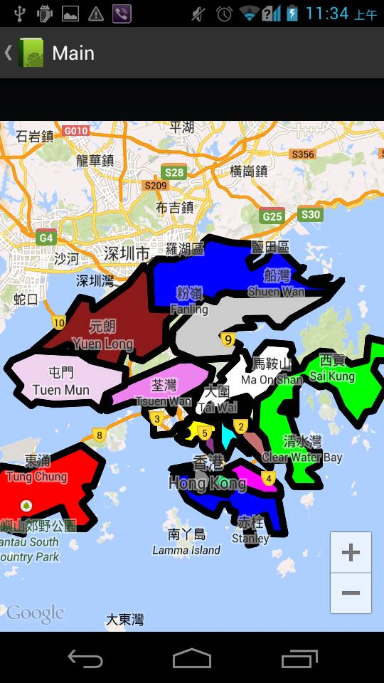
4. Dividing Google map in 18 districts manner
How could I can get the data for each edges of 18 districts?
Some are provided through the internet resources
Some are marked by myself . . . .

Slide 12
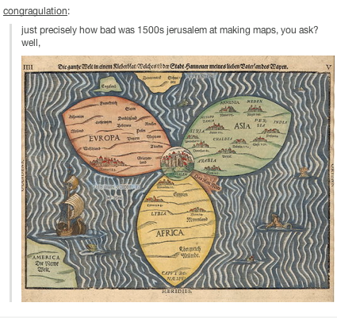
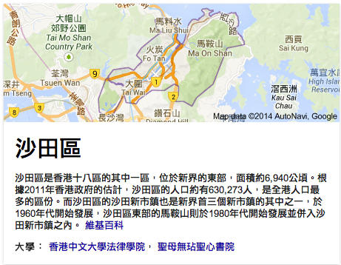
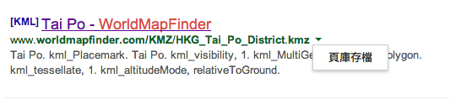
Comparison and Joke
http://www.worldmapfinder.com/KMZ/HKG_Tai_Po_District.kmz

Slide 13
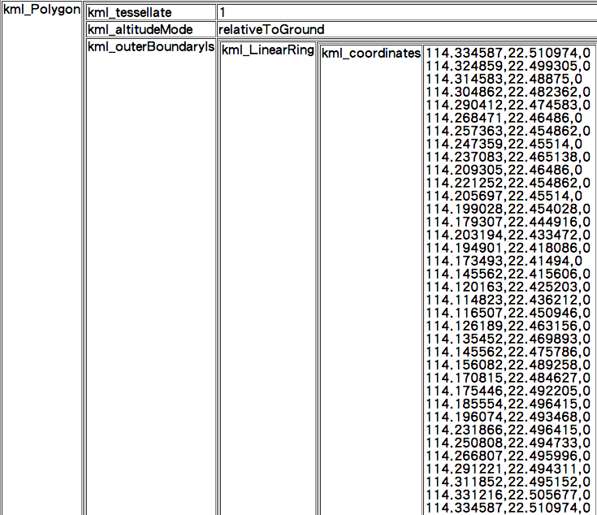
Latitude and longitude.

Slide 14
5. Ray casting with polygons
These polygons are not implemented with onclicklistener like button. . .
How can I know the user is clicking on the particular polygon?
Sorry :’(

Slide 15
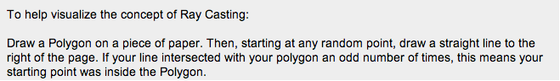
Ray casting. . . .
Source: http://stackoverflow.com/questions/14405593/polygon-touch-detection-google-map-api-v2
An early description of the problem in computer graphics shows two common approaches (ray casting and angle summation) in use as early as 1974.[1] (wikipedia)

Slide 16
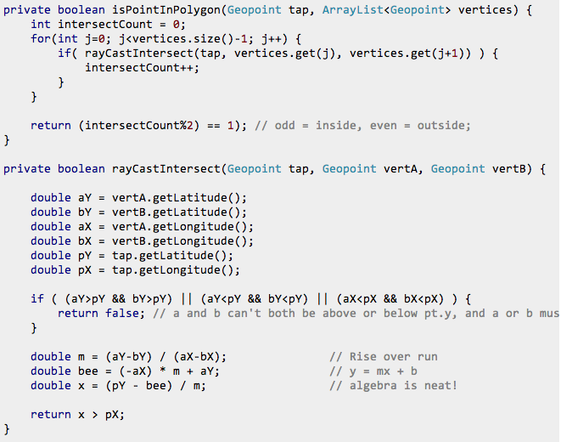
Reference and Source code: http://stackoverflow.com/questions/14405593/polygon-touch-detection-google-map-api-v2

Slide 17
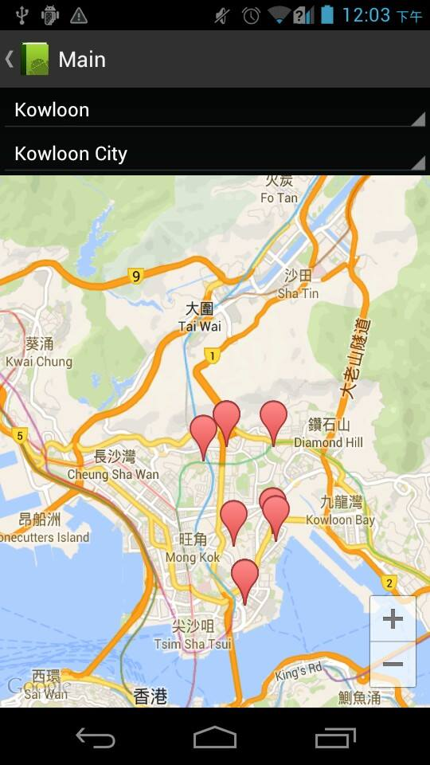
6. Too many markers on the map
https://developers.google.com/maps/documentation/android/utility/

Slide 18
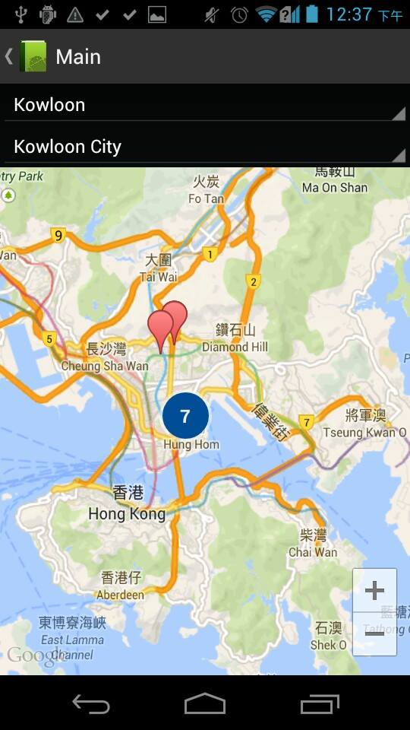
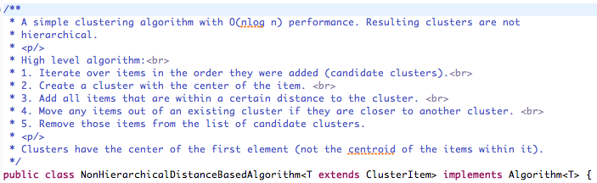
Solution : marker clustering
Group the markers together . . .
Thank you Google maps
utility library / packages
For providing the code. . .

Slide 19
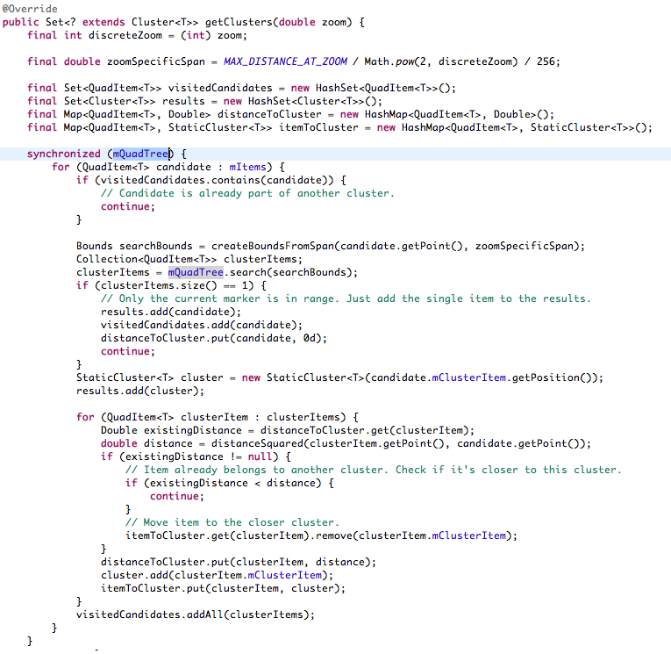
Source : https://developers.google.com/maps/documentation/android/utility/

Slide 20
7.Collaborative Filtering
A recommendation method for suggesting items for users
It is a large scope problem that could be a big project as a standalone problem . . .
After a series of searching . . . . .
I have used a famous algorithm of collaborative filtering – Slope one (item-based)
From the author’s source code.
Source : http://lemire.me/fr/documents/publications/webpaper.txt

Slide 21
Why Slope one?
“easy to implement”
“updateable on the fly”
“efficient at query time”
“expect little from first visitor”
Part / core element(s) of open packages e.g. Apache Mahout and Easyrec.
“Slope One Predictors for Online Rating-Based Collaborative Filtering“
Source :http://lemire.me/fr/documents/publications/lemiremaclachlan_sdm05.pdf

Slide 22
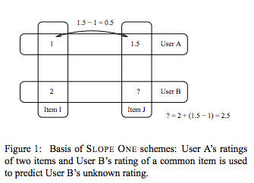
Basic ideas
Adapted from “Slope One Predictors for Online Rating-Based Collaborative Filtering”
http://lemire.me/fr/documents/publications/lemiremaclachlan_sdm05.pdf

Slide 23
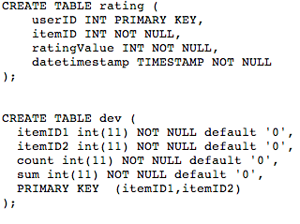
General ideas:
Update the dev table everytime
Source : http://lemire.me/fr/documents/publications/webpaper.txt

Slide 24
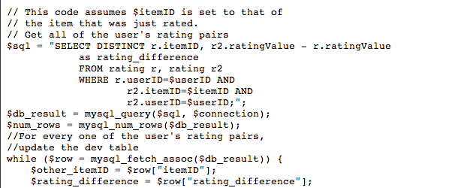
General ideas:
2) Get the rating differences of all items he have rated in comparing the product he has just rated
Source : http://lemire.me/fr/documents/publications/webpaper.txt

Slide 25
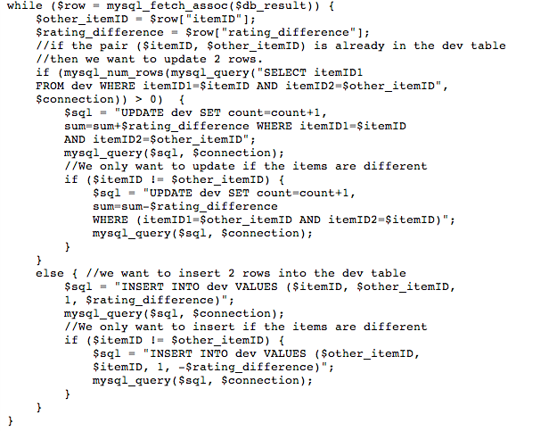
General ideas:
2) Get the rating differences of all items he have rated in comparing the product he has just rated
Source : http://lemire.me/fr/documents/publications/webpaper.txt

Slide 26
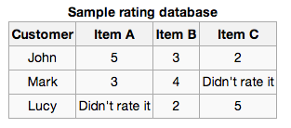
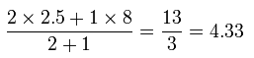
Predict
For all users
(1)item A over B =((5-3) + (3-4))/2 = 0.5
(2)Item A over C = 3
Lucy gives item B with 2
Lucy gives item B with 5
+ (1) = 2.5
5 + (2) = 8
Predict Lucy on item A’s value?
Get the average rating difference of item A over other elements (e.g. item A over B ((5-3) + (3-4))/2 = 0.5))
He purpose to use Lucy’s rating on item B as a base value
Predicted rating

Slide 27
8.Scanning Barcode and information retrieval
Open the camera
Call the barcode library Zxing
https://github.com/zxing/zxing
scan the barcode
Information retrieval by ISBN from JSON web services

Slide 28
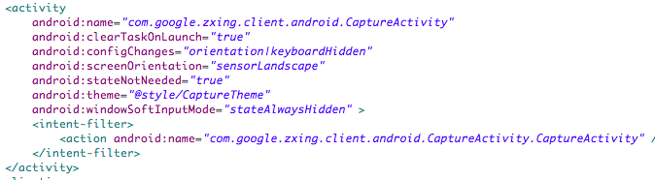
8.Scanning Barcode and information retrieval

Slide 29
Case Study : aNobii Anobium punctatum
A social network website created by Greg Sung
An online bookshelf for people to share their book
However, it doesn’t help users to sell their book.
User-generated content
An international app acquired by HMV

Slide 30
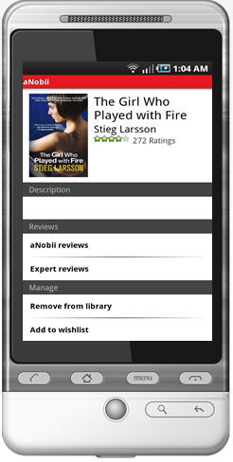
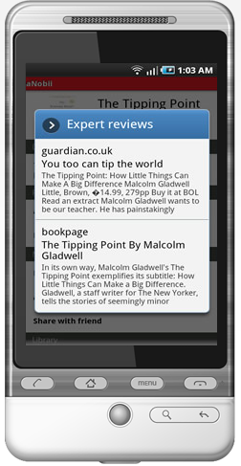
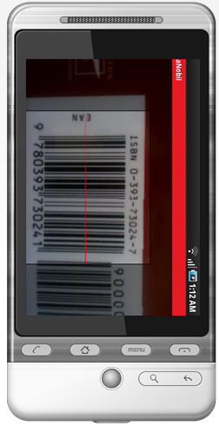

Slide 31
iEditio - Ordinary functions and flow
Login
Create account
List of second hand book
List of second hand book by districts
List of second hand book by map
Rating, comments, purchase , social media
Selling barcode via scanning barcode
Discover hot books currently
Search Your Book your want

Slide 32
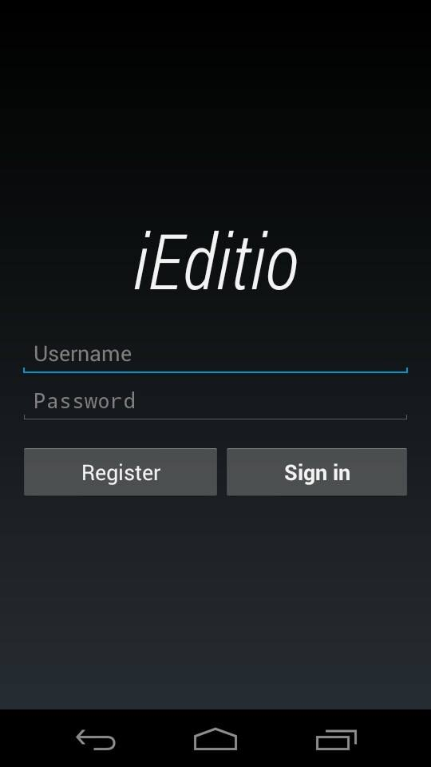
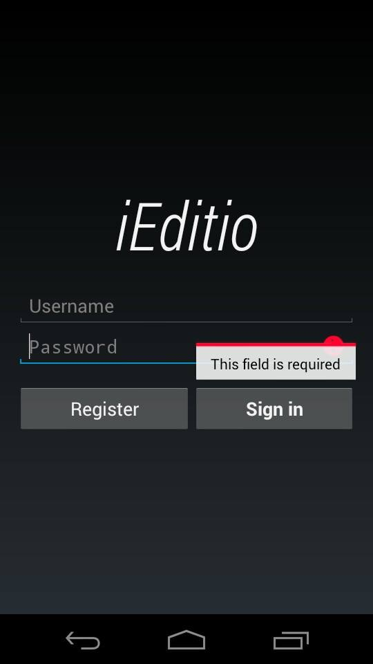
Robot fonts
Provided
By Android

Slide 33
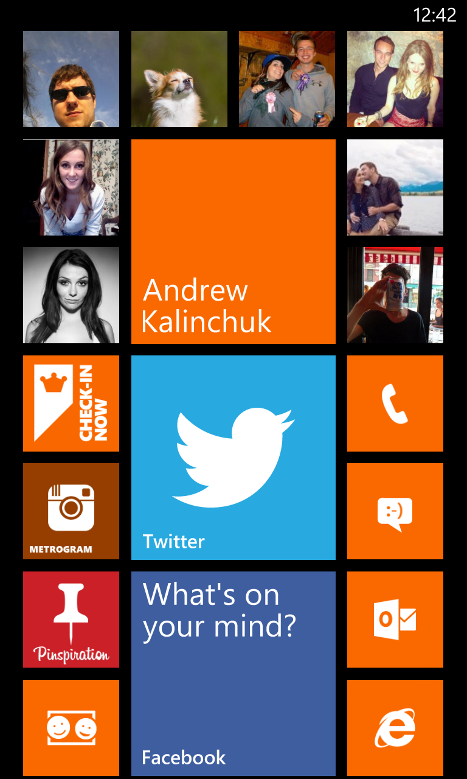
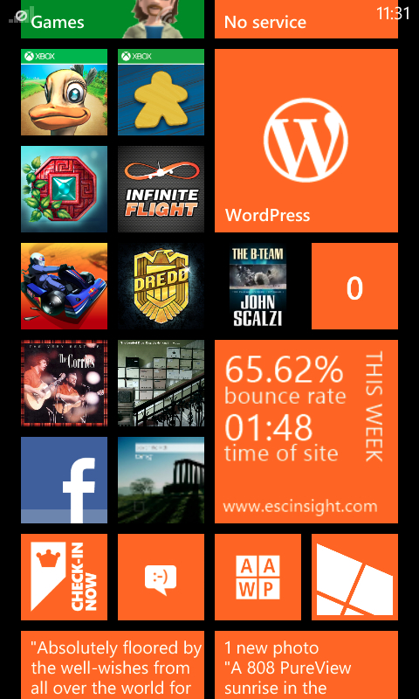
Lessons learned from window phone
Minimalism
Simple layout
Large icon
So called the metro style

Slide 34
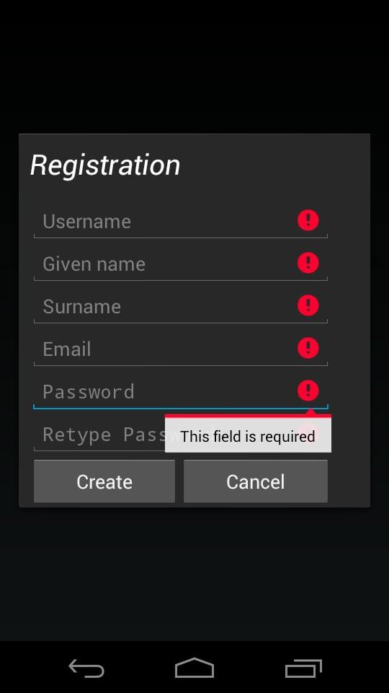
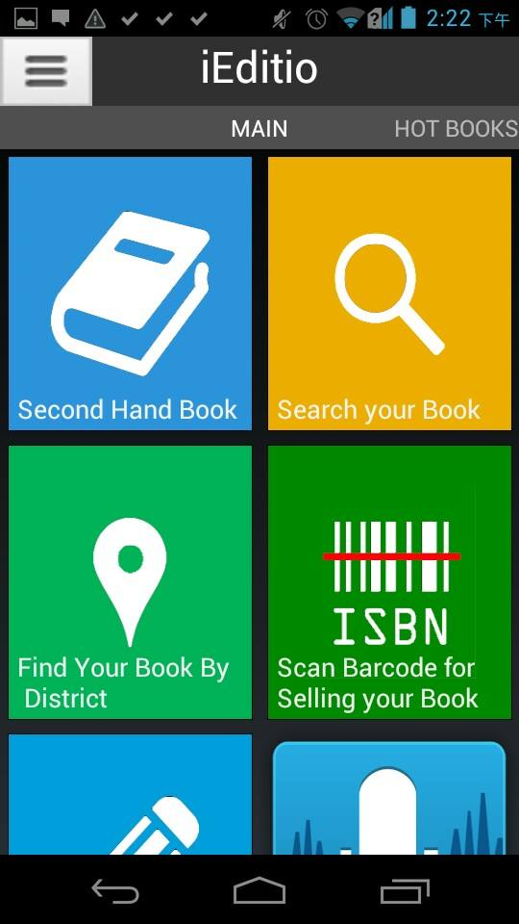

Slide 35
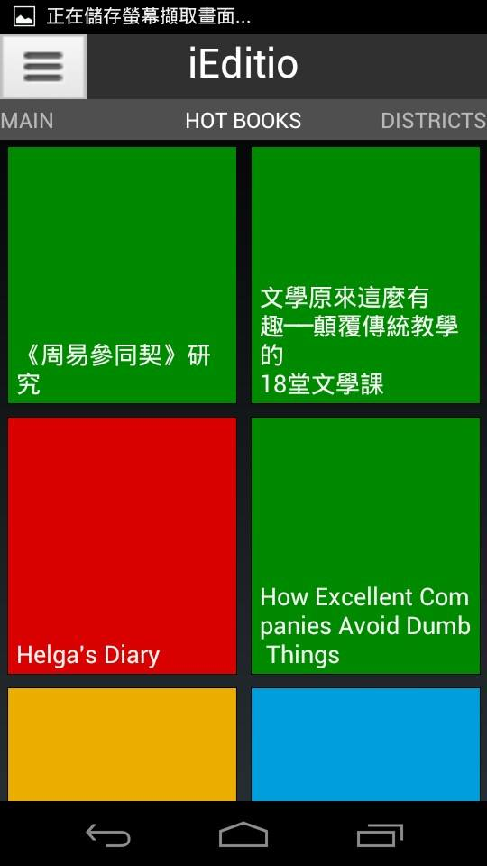
Swipe layout
Information of Hot books gathered from Hong Kong Commercial press
http://www.cp1897.com.hk/wiki/index.php
It looks like developed by mainland developers. . .

Slide 36
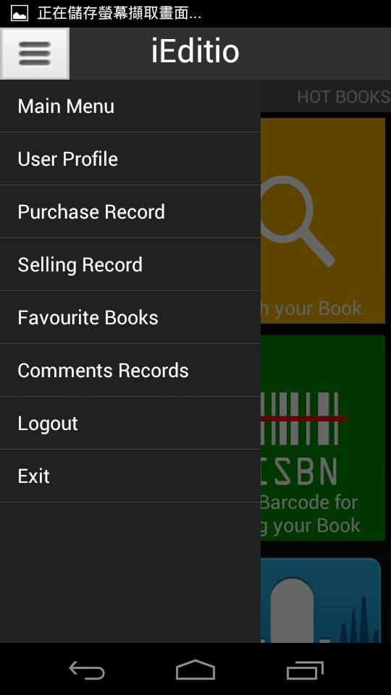
Navigation drawer
Each one should be a fragment . . .
However, I am unable to implement in fragment manner…
It was crushed with the swipe layout . . .
I am doing in the activity approach

Slide 37
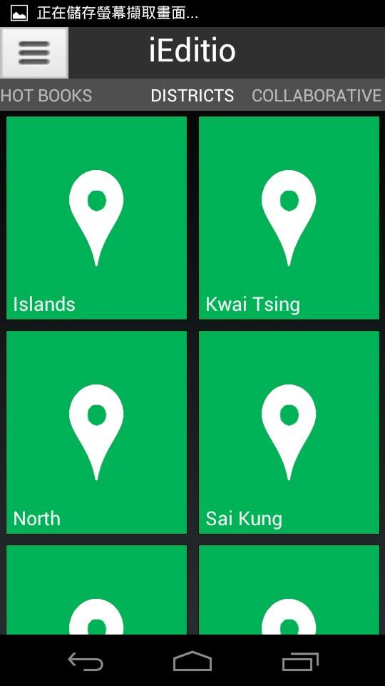
Find Your Books on 18 districts

Slide 38
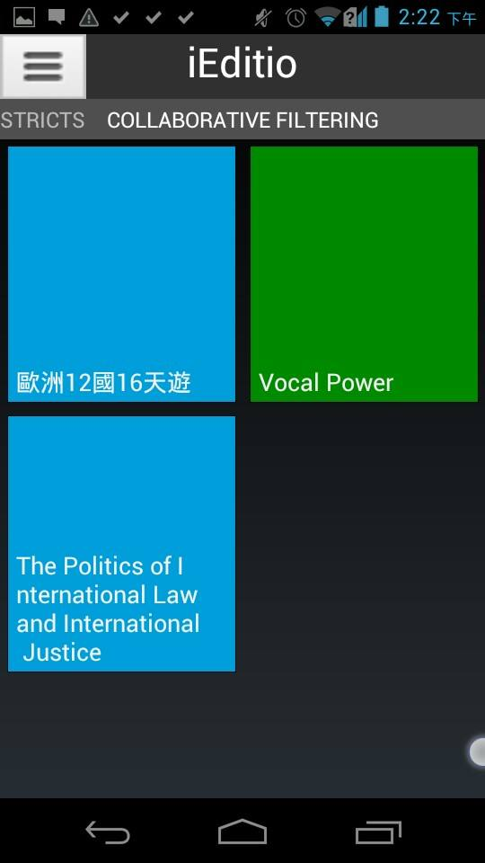
Rating and item-based Collaborative filtering

Slide 39
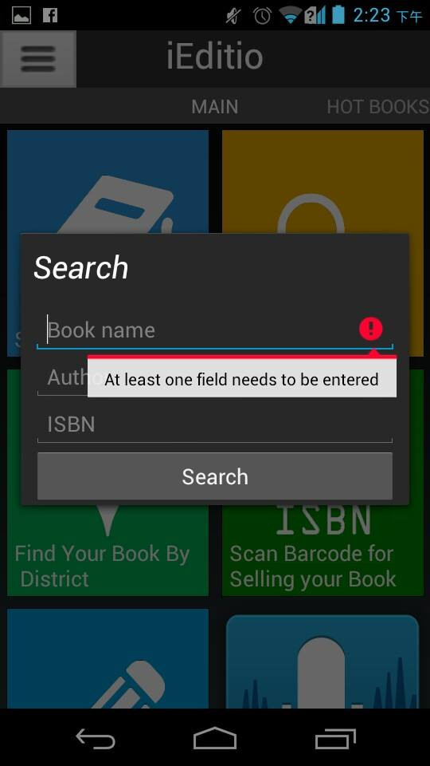
Search query towards douban web database

Slide 40
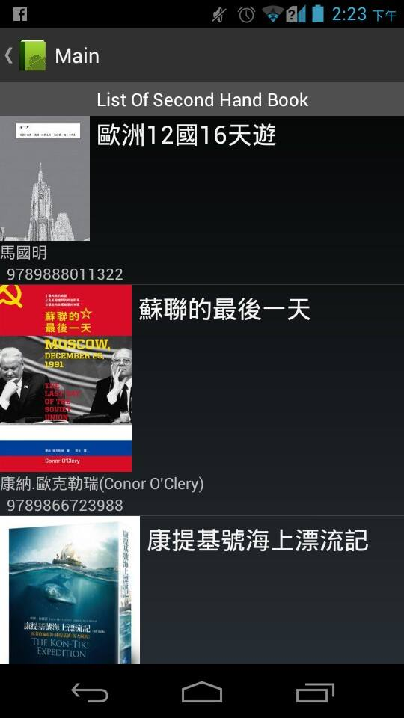
List Of Second Hand Book

Slide 41
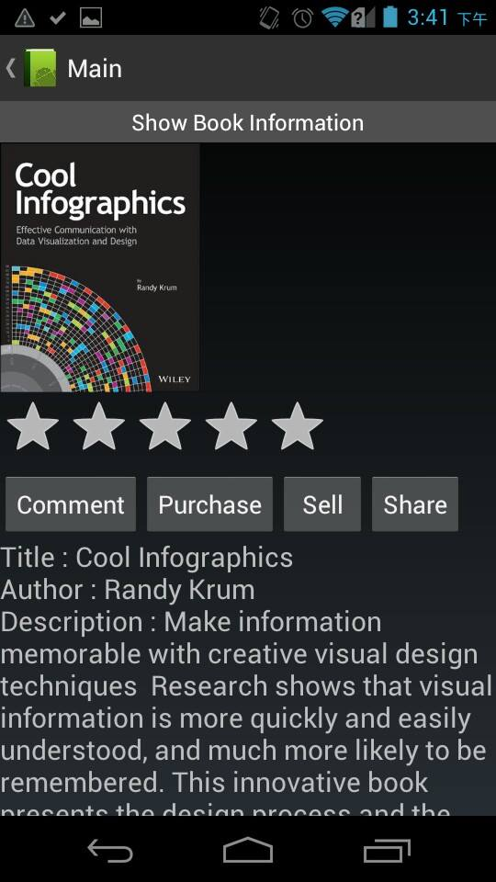
Book Information
Dynamically download the cover and related information

Slide 42
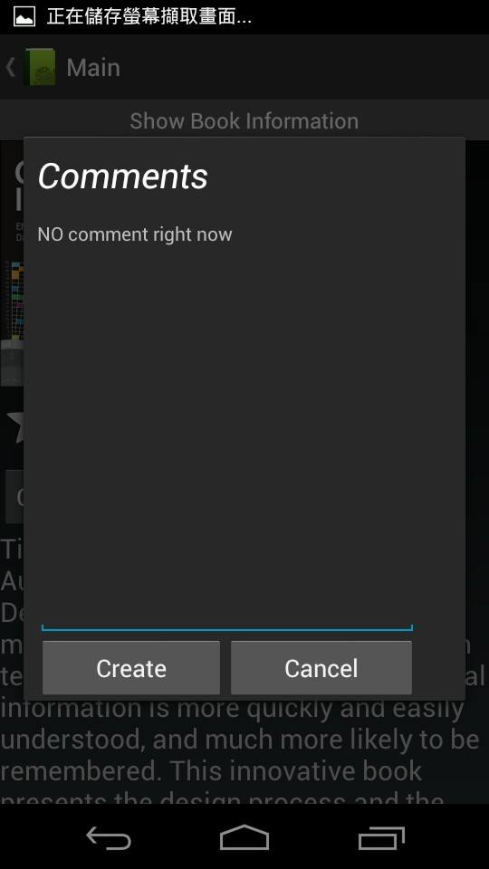
Give feedback and read other’s comments

Slide 43
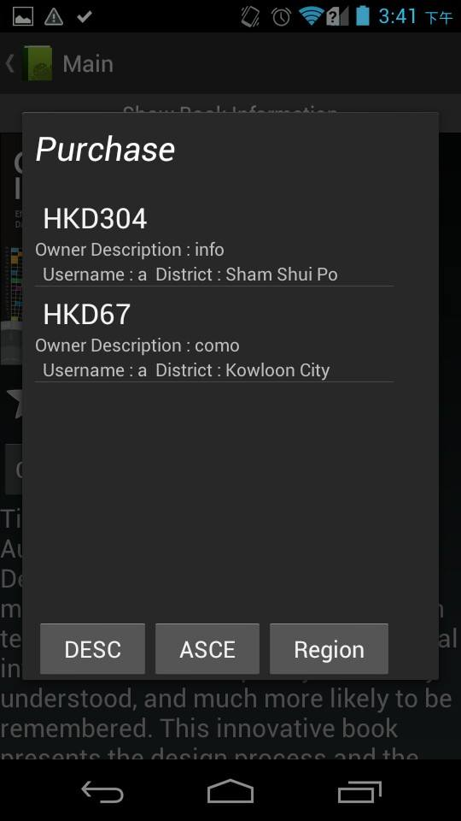
List of related purchased

Slide 44
List of related purchased
Ascending and descending sorting

Slide 45
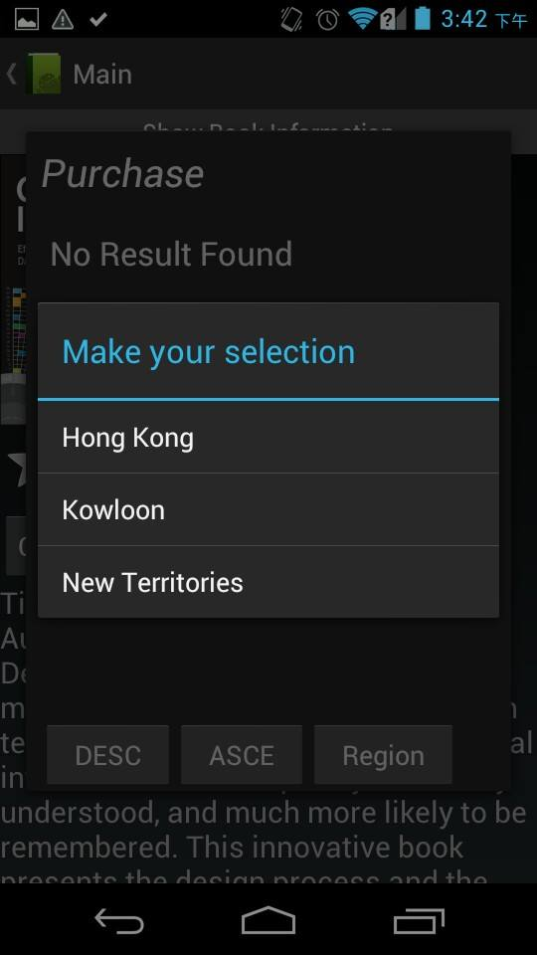
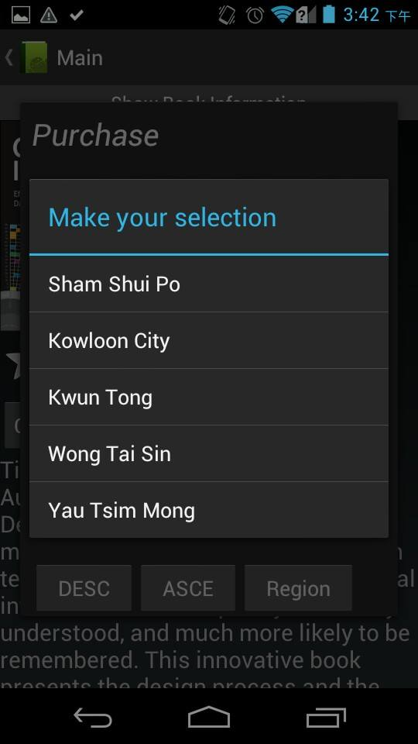
Districts…

Slide 46
Districts…

Slide 47
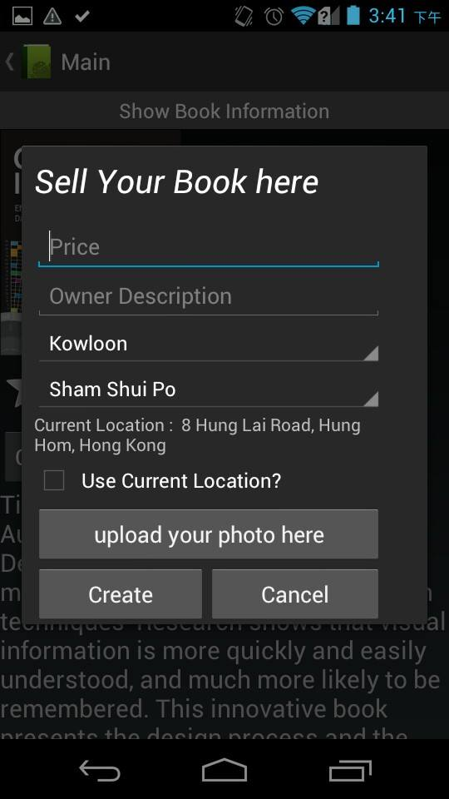
Selling …
Getting your GPS, address and districts….

Slide 48
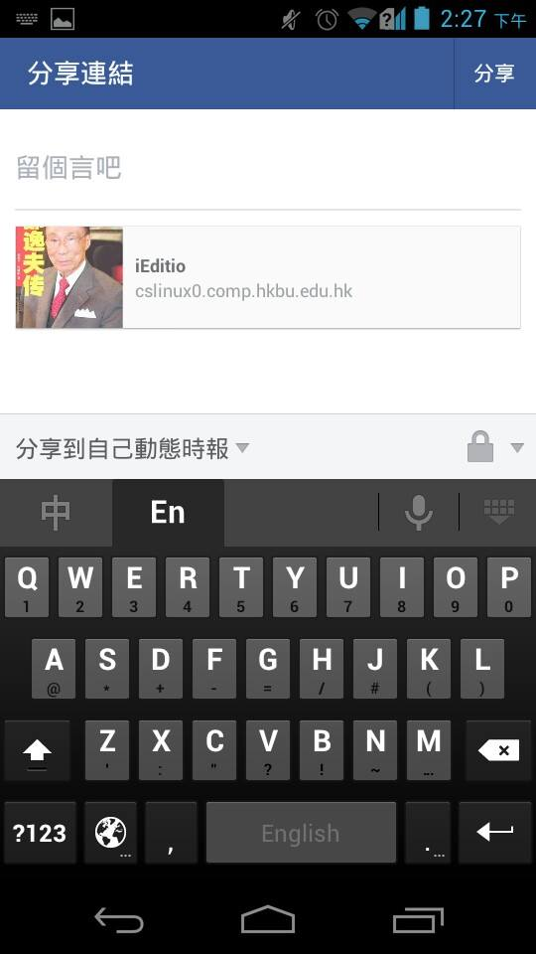
Facebook sharing

Slide 49
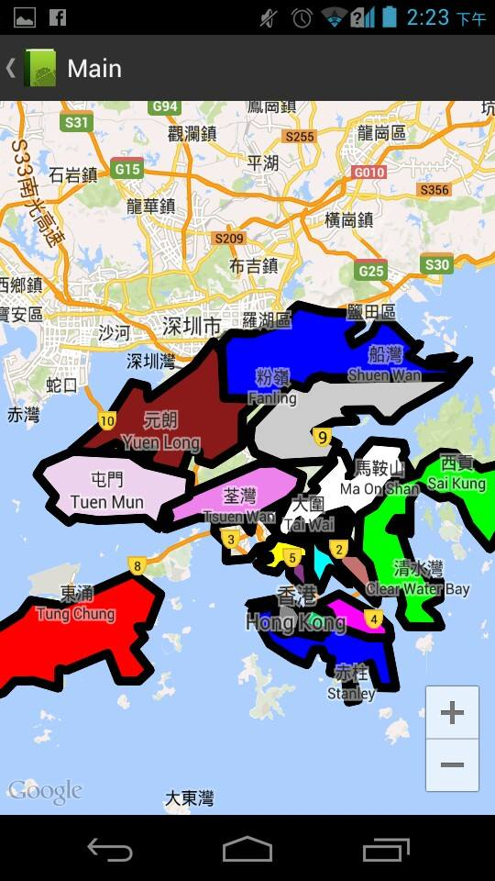
18 districts map

Slide 51
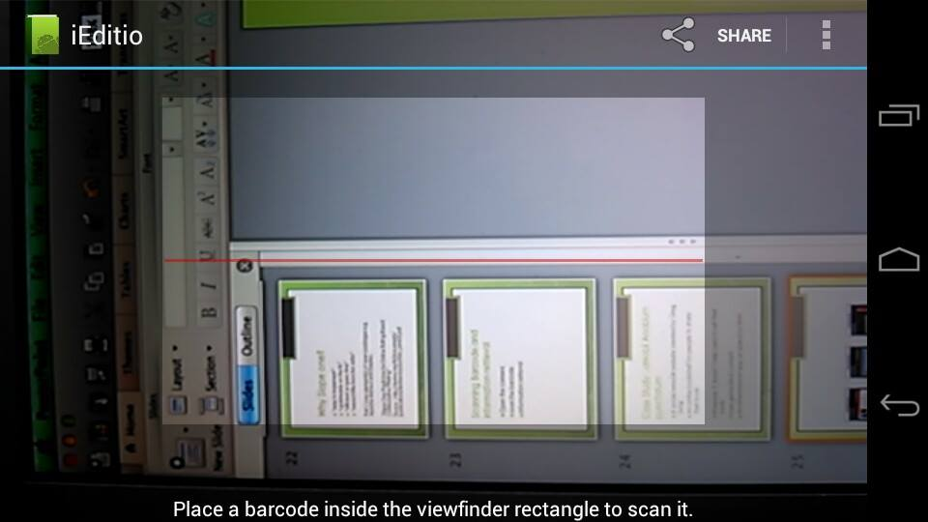
Scan barcode

Slide 52
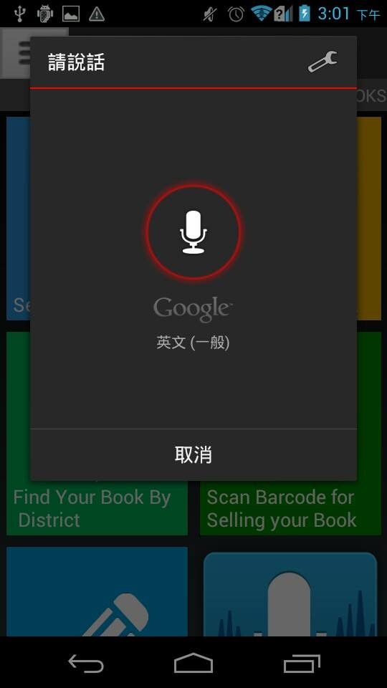
Voice Control

Slide 53


Slide 54


Slide 55



Slide 56


Slide 57


Slide 58
DEMO
Q AND A

